Slide 1
Chapter 5 & 8

Slide 2
Requirements Engineering-I
Inception—ask a set of questions that establish …
  basic understanding of the problem
  the people who want a solution
  the nature of the solution that is desired, and
  the effectiveness of preliminary communication and collaboration between the customer and the developer
Elicitation—elicit requirements from all stakeholders
Elaboration—create an analysis model that identifies data, function and behavioral requirements
Negotiation—agree on a deliverable system that is realistic for developers and customers

Slide 3
Requirements Engineering-II
Specification—can be any one (or more) of the following:
  A written document
  A set of models
  A formal mathematical
  A collection of user scenarios (use-cases)
  A prototype
Validation—a review mechanism that looks for
  errors in content or interpretation
  areas where clarification may be required
  missing information
  inconsistencies (a major problem when large products or systems are engineered)
  conflicting or unrealistic (unachievable) requirements.
Requirements management

Slide 4
Inception
Identify stakeholders
  “who else do you think I should talk to?”
Recognize multiple points of view
Work toward collaboration
The first questions
  Who is behind the request for this work?
  Who will use the solution?
  What will be the economic benefit of a successful solution
  Is there another source for the solution that you need?

Slide 5
Eliciting Requirements
meetings are conducted and attended by both software engineers and customers
rules for preparation and participation are established
an agenda is suggested
a "facilitator" (can be a customer, a developer, or an outsider) controls the meeting
a "definition mechanism" (can be work sheets, flip charts, or wall stickers or an electronic bulletin board, chat room or virtual forum) is used
the goal is
  to identify the problem
  propose elements of the solution
  negotiate different approaches, and
  specify a preliminary set of solution requirements

Slide 6
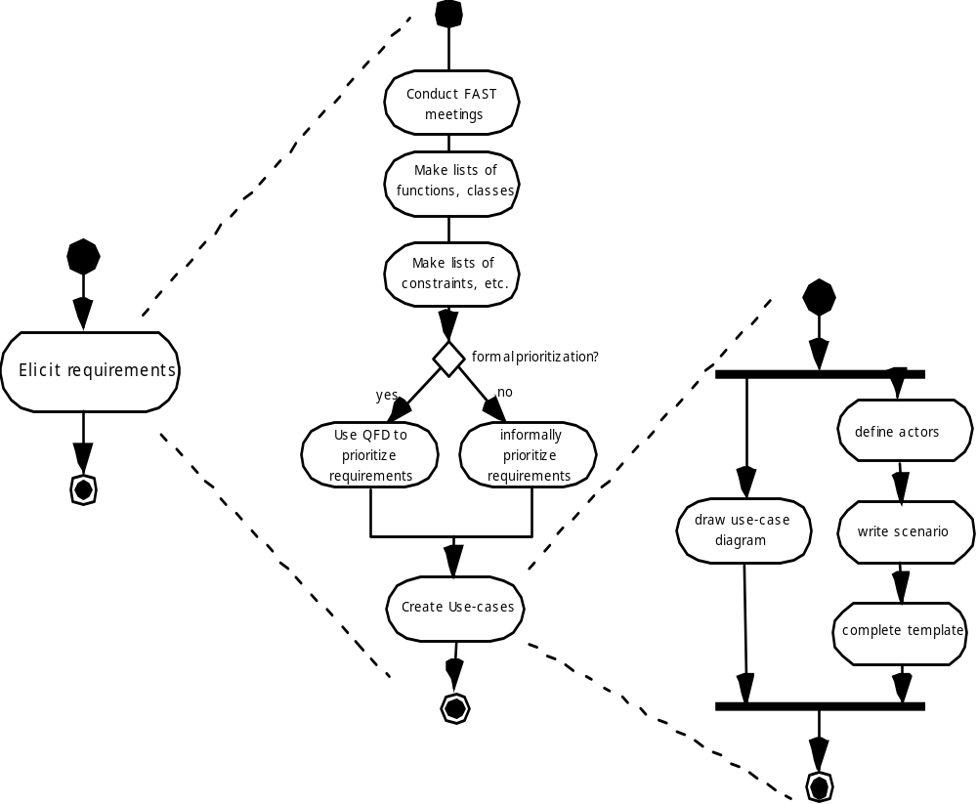
Eliciting Requirements

Slide 7
Quality Function Deployment
Function deployment determines the “value” (as perceived by the customer) of each function required of the system
Information deployment identifies data objects and events
Task deployment examines the behavior of the system
Value analysis determines the relative priority of requirements

Slide 8
Elicitation Work Products
a statement of need and feasibility.
a bounded statement of scope for the system or product.
a list of customers, users, and other stakeholders who participated in requirements elicitation
a description of the system’s technical environment.
a list of requirements (preferably organized by function) and the domain constraints that apply to each.
a set of usage scenarios that provide insight into the use of the system or product under different operating conditions.
any prototypes developed to better define requirements.

Slide 9
Building the Analysis Model
Elements of the analysis model
  Scenario-based elements
    Functional—processing narratives for software functions
    Use-case—descriptions of the interaction between an “actor” and the system
  Class-based elements
    Implied by scenarios
  Behavioral elements
    State diagram
  Flow-oriented elements
    Data flow diagram

Slide 10
Use-Cases
A collection of user scenarios that describe the thread of usage of a system
Each scenario is described from the point-of-view of an “actor”—a person or device that interacts with the software in some way
Each scenario answers the following questions:
  Who is the primary actor, the secondary actor (s)?
  What are the actor’s goals?
  What preconditions should exist before the story begins?
  What main tasks or functions are performed by the actor?
  What extensions might be considered as the story is described?
  What variations in the actor’s interaction are possible?
  What system information will the actor acquire, produce, or change?
  Will the actor have to inform the system about changes in the external environment?
  What information does the actor desire from the system?
  Does the actor wish to be informed about unexpected changes?

Slide 11
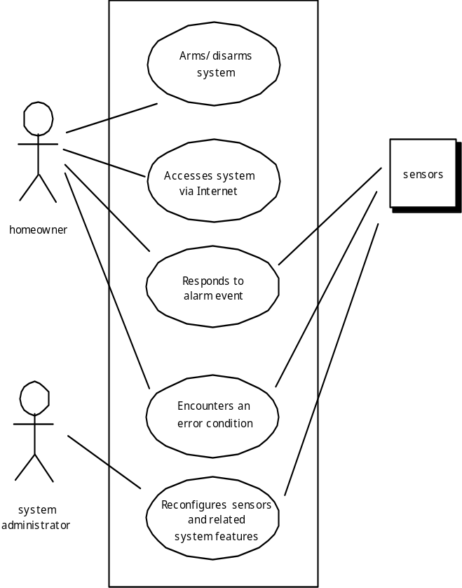
Use-Case Diagram

Slide 12
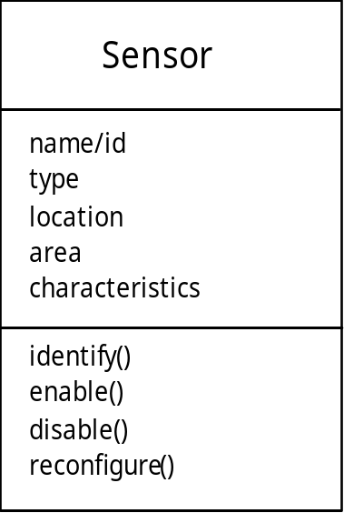
Class Diagram
From the SafeHome system …

Slide 13
State Diagram
Reading
Commands
State name
System status = “ready”
Display msg = “enter cmd”
Display status = steady
State variables
Entry/subsystems ready
Do: poll user input panel
Do: read user input
Do: interpret user input
State activities

Slide 14
Design
Mitch Kapor, the creator of Lotus 1-2-3, presented a “software design manifesto” in Dr. Dobbs Journal. He said:
  Good software design should exhibit:
  Firmness: A program should not have any bugs that inhibit its function.
  Commodity: A program should be suitable for the purposes for which it was intended.
  Delight: The experience of using the program should be pleasurable one.

Slide 15

Analysis Model -> Design Model

Slide 16
Design Principles
The design process should not suffer from ‘tunnel vision.’
The design should be traceable to the analysis model.
The design should not reinvent the wheel.
The design should “minimize the intellectual distance” [DAV95] between the software and the problem as it exists in the real world.
The design should exhibit uniformity and integration.
The design should be structured to accommodate change.
The design should be structured to degrade gently, even when aberrant data, events, or operating conditions are encountered.
Design is not coding, coding is not design.
The design should be assessed for quality as it is being created, not after the fact.
The design should be reviewed to minimize conceptual (semantic) errors.
From Davis [DAV95]

Slide 17
Fundamental Concepts
Abstraction—data, procedure, control
Architecture—the overall structure of the software
Patterns—”conveys the essence” of a proven design solution
Separation of concerns—any complex problem can be more easily handled if it is subdivided into pieces
Modularity—compartmentalization of data and function
Hiding—controlled interfaces
Functional independence—single-minded function and low coupling
Refinement—elaboration of detail for all abstractions
Aspects—a mechanism for understanding how global requirements affect design
Refactoring—a reorganization technique that simplifies the design
OO design concepts—Appendix II
Design Classes—provide design detail that will enable analysis classes to be implemented

Slide 18
Data Abstraction
door
manufacturer
model number
type
swing direction
inserts
lights
type
number
weight
opening mechanism
implemented as a data structure

Slide 19
Procedural Abstraction
open
details of enter
algorithm
implemented with a "knowledge" of the
object that is associated with enter

Slide 20
Architecture
“The overall structure of the software and the ways in which that structure provides conceptual integrity for a system.” [SHA95a]
Structural properties. This aspect of the architectural design representation defines the components of a system (e.g., modules, objects, filters) and the manner in which those components are packaged and interact with one another. For example, objects are packaged to encapsulate both data and the processing that manipulates the data and interact via the invocation of methods
Extra-functional properties. The architectural design description should address how the design architecture achieves requirements for performance, capacity, reliability, security, adaptability, and other system characteristics.
Families of related systems. The architectural design should draw upon repeatable patterns that are commonly encountered in the design of families of similar systems. In essence, the design should have the ability to reuse architectural building blocks.

Slide 21
Patterns
Design Pattern Template
Pattern name—describes the essence of the pattern in a short but expressive name
Intent—describes the pattern and what it does
Also-known-as—lists any synonyms for the pattern
Motivation—provides an example of the problem
Applicability—notes specific design situations in which the pattern is applicable
Structure—describes the classes that are required to implement the pattern
Participants—describes the responsibilities of the classes that are required to implement the pattern
Collaborations—describes how the participants collaborate to carry out their responsibilities
Consequences—describes the “design forces” that affect the pattern and the potential trade-offs that must be considered when the pattern is implemented
Related patterns—cross-references related design patterns

Slide 22
Separation of Concerns
Any complex problem can be more easily handled if it is subdivided into pieces that can each be solved and/or optimized independently
A concern is a feature or behavior that is specified as part of the requirements model for the software
By separating concerns into smaller, and therefore more manageable pieces, a problem takes less effort and time to solve.

Slide 23
Modularity
"modularity is the single attribute of software that allows a program to be intellectually manageable" [Mye78].
Monolithic software (i.e., a large program composed of a single module) cannot be easily grasped by a software engineer.
  The number of control paths, span of reference, number of variables, and overall complexity would make understanding close to impossible.
In almost all instances, you should break the design into many modules, hoping to make understanding easier and as a consequence, reduce the cost required to build the software.

Slide 24
Modularity: Trade-offs
What is the "right" number of modules
for a specific software design?
module development cost
cost of
software
module
integration
cost
optimal number
number of modules
of modules

Slide 25
Information Hiding
module
• algorithm
controlled
interface
• data structure
• details of external interface
• resource allocation policy
clients
"secret"
a specific design decision

Slide 26
Why Information Hiding?
reduces the likelihood of “side effects”
limits the global impact of local design decisions
emphasizes communication through controlled interfaces
discourages the use of global data
leads to encapsulation—an attribute of high quality design
results in higher quality software

Slide 27
Stepwise Refinement
open
walk to door;
reach for knob;
open door;
repeat until door opens
turn knob clockwise;
walk through;
if knob doesn't turn, then
close door.
take key out;
find correct key;
insert in lock;
endif
pull/push door
move out of way;
end repeat

Slide 28

Sizing Modules: Two Views

Slide 29
Functional Independence
Functional independence is achieved by developing modules with "single-minded" function and an "aversion" to excessive interaction with other modules.
Cohesion is an indication of the relative functional strength of a module.
  A cohesive module performs a single task, requiring little interaction with other components in other parts of a program. Stated simply, a cohesive module should (ideally) do just one thing.
Coupling is an indication of the relative interdependence among modules.
  Coupling depends on the interface complexity between modules, the point at which entry or reference is made to a module, and what data pass across the interface.

Slide 30
Refactoring
Fowler [FOW99] defines refactoring in the following manner:
  "Refactoring is the process of changing a software system in such a way that it does not alter the external behavior of the code [design] yet improves its internal structure.”
When software is refactored, the existing design is examined for
  redundancy
  unused design elements
  inefficient or unnecessary algorithms
  poorly constructed or inappropriate data structures
  or any other design failure that can be corrected to yield a better design.

Slide 31
OO Design Concepts
Design classes
  Entity classes
  Boundary classes
  Controller classes
Inheritance—all responsibilities of a superclass is immediately inherited by all subclasses
Messages—stimulate some behavior to occur in the receiving object
Polymorphism—a characteristic that greatly reduces the effort required to extend the design

Slide 32
Design Classes
Analysis classes are refined during design to become entity classes
Boundary classes are developed during design to create the interface (e.g., interactive screen or printed reports) that the user sees and interacts with as the software is used.
  Boundary classes are designed with the responsibility of managing the way entity objects are represented to users.
Controller classes are designed to manage
  the creation or update of entity objects;
  the instantiation of boundary objects as they obtain information from entity objects;
  complex communication between sets of objects;
  validation of data communicated between objects or between the user and the application.

Slide 33

The Design Model

Slide 34
Design Model Elements
Data elements
  Data model --> data structures
  Data model --> database architecture
Architectural elements
  Application domain
  Analysis classes, their relationships, collaborations and behaviors are transformed into design realizations
  Patterns and “styles” (Chapters 9 and 12)
Interface elements
  the user interface (UI)
  external interfaces to other systems, devices, networks or other producers or consumers of information
  internal interfaces between various design components.
Component elements
Deployment elements

Slide 35
Architectural Elements
The architectural model [Sha96] is derived from three sources:
  information about the application domain for the software to be built;
  specific requirements model elements such as data flow diagrams or analysis classes, their relationships and collaborations for the problem at hand, and
  the availability of architectural patterns (Chapter 12) and styles (Chapter 9).

Slide 36
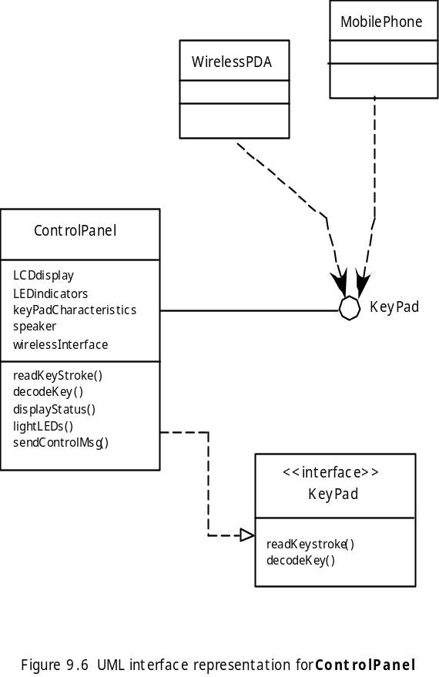
Interface Elements

Slide 37
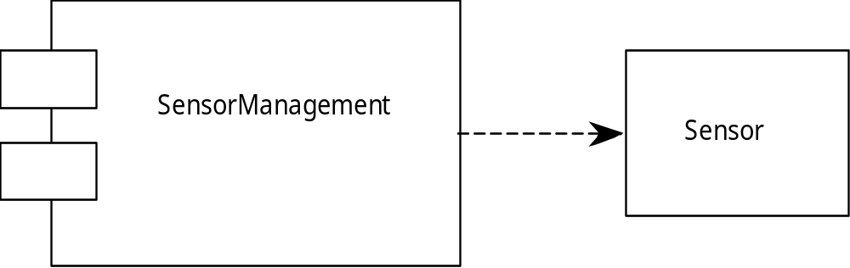
Component Elements

Slide 38
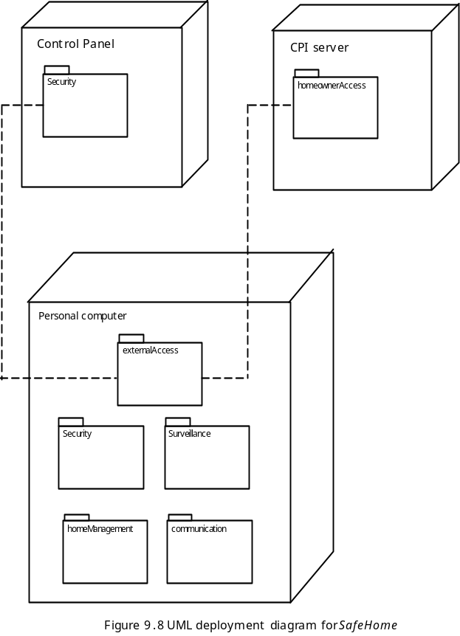
Deployment Elements

